Slide 1


Cancer Facts & Figures For Hispanic/Latino People 2024-2026
Please note that ACS reserves all rights with respect to this publication and the materials provided herein. Any reproduction or re-use of this publication or portions of it, should credit the American Cancer Society Cancer Facts and Figures for Hispanic/Latino People 2024-2026 publication. For permissions, please email the ACS Legal Department at permissionrequest@cancer.org.

Slide 2
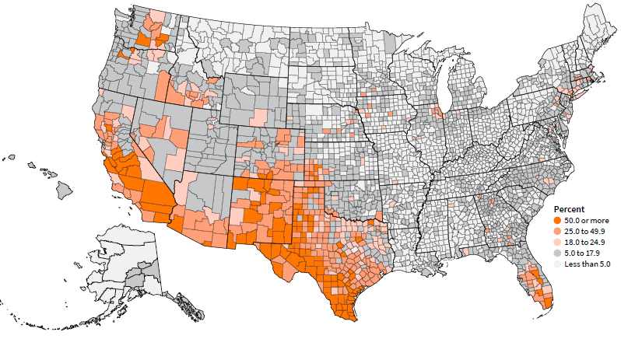
Hispanic Population Distribution as a Percent of Total County Populationª
Cancer Facts & Figures for Hispanic/Latino People 2024-2026
ª2021 population estimates used for Connecticut counties due to recent change in county equivalents.
Source: US Census Bureau, Population Estimates, July 1, 2022. Released 2023.
©2024, American Cancer Society, Inc., Surveillance and Health Equity Science
Notes:
The Hispanic population is mostly concentrated in the Southwest and Florida.

Slide 3
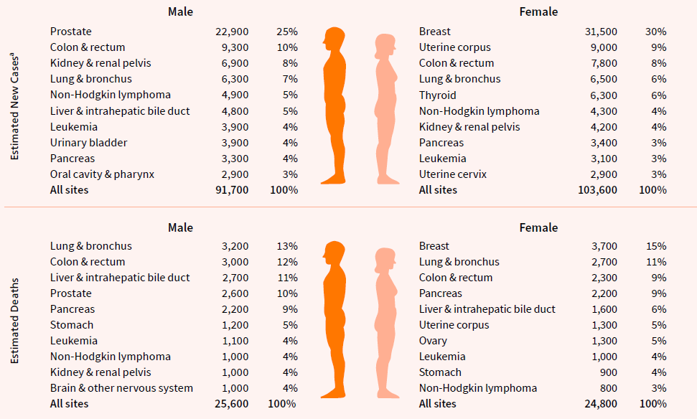
Leading Sites of New Cancer Cases and Deaths in Hispanic People, US, 2024
Cancer Facts & Figures for Hispanic/Latino People 2024-2026
ªEstimates exclude basal and squamous cell skin cancers and in situ carcinoma except urinary bladder. Estimates do not reflect the impact of the COVID-19 pandemic on cancer cases or deaths.
©2024, American Cancer Society, Inc., Surveillance and Health Equity Science
Notes:
In 2024, an estimated 195,300 cancer cases will be diagnosed in Hispanic people in the US and 50,400 Hispanic people will die from the disease.

Slide 4
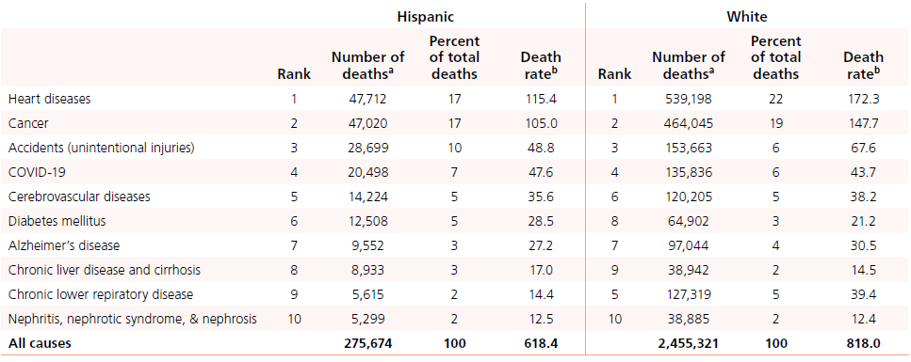
Leading Causes of Death in Hispanic and White People, US, 2022
Cancer Facts & Figures for Hispanic/Latino People 2024-2026
ªExcludes unknown ages.
^{b}Rates are per 100,000 and age adjusted to the 2000 US standard population.
White=Non-Hispanic White. Death rates are not directly comparable to those published in prior years due to updated population denominator data.
©2024, American Cancer Society, Inc., Surveillance and Health Equity Science
Notes:
Heart diseases and cancer each account for approximately 17% of deaths in the US Hispanic population.

Slide 5
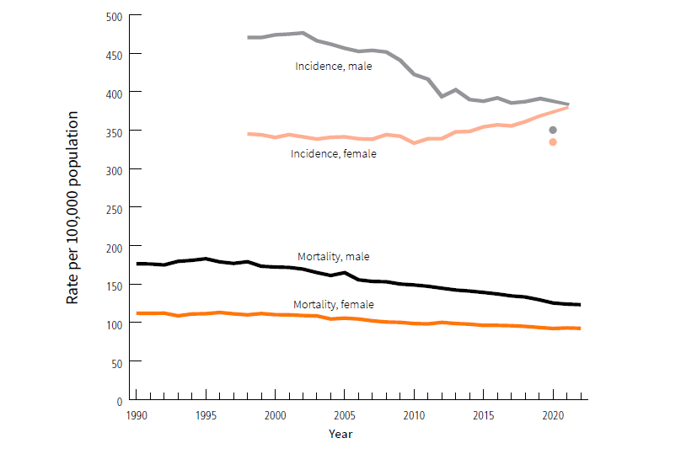
Trends in Incidence (1998-2021) and Mortality (1990-2022) for All Cancers Combined in Hispanic People, US
Cancer Facts & Figures for Hispanic/Latino People 2024-2026
Rates are age adjusted to the 2000 US standard population. Incidence rates are adjusted for delays in reporting, and trend lines for incidence exclude 2020. Mortality data in Louisiana, New Hampshire, and Oklahoma were excluded from overall death rates for years in which information on Hispanic origin were not available.
Sources: Incidence – North American Association of Central Cancer Registries 2024. Mortality – National Center for Heath Statistics, Centers for Disease Control and Prevention, 2024.
©2024, American Cancer Society, Inc., Surveillance and Health Equity Science
Notes:
While incidence rates in Hispanic men have remained stable since 2012, rates among Hispanic women have been increasing by 1% per year since 2011, largely reflecting rising trends in breast and uterine corpus cancers. During 2013-2022, the death rate for all cancers combined decreased by an average of 1.7% and 0.7% per year in Hispanic men and women, respectively.

Slide 6
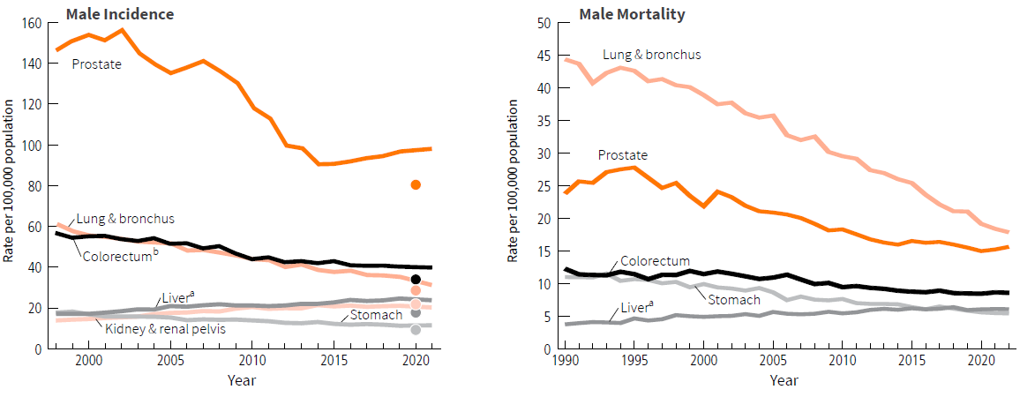
Trends in Incidence (1998-2021) and Mortality (1990-2022) in Hispanic Males for Selected Cancers, US
Cancer Facts & Figures for Hispanic/Latino People 2024-2026
Rates are age adjusted to the 2000 US standard population. Incidence rates are adjusted for delays in reporting, and trend lines for incidence exclude 2020. Mortality data in Louisiana, New Hampshire, and Oklahoma were excluded from overall death rates for years in which information on Hispanic origin were not available. aIncludes liver and intrahepatic bile duct. ^{b}Colorectum excludes appendiceal cancer. Figures are shown on different scales to emphasize trends.
Sources: Incidence – North American Association of Central Cancer Registries, 2024. Mortality – National Center for Heath Statistics, Centers for Disease Control and Prevention, 2024.
©2024, American Cancer Society, Inc., Surveillance and Health Equity Science
Notes:
Prostate cancer incidence among Hispanic men generally declined from the early 2000s until 2014 but has since increased by about 1% per year, whereas the mortality rate has stabilized after steep declines during the 2000s.

Slide 7
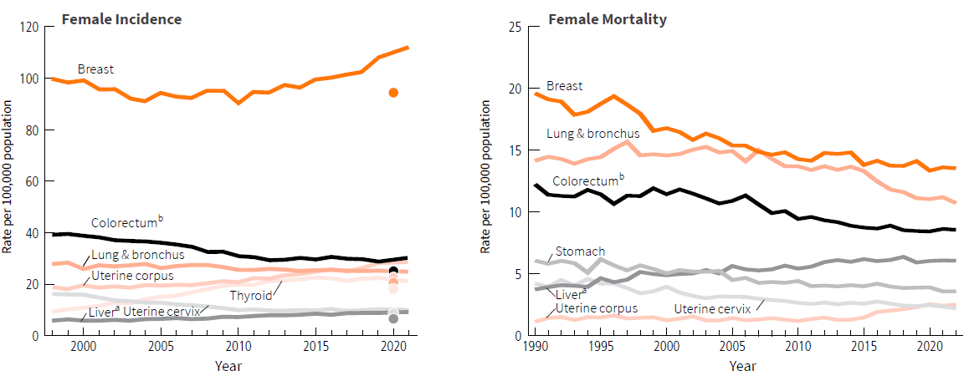
Trends in Incidence (1998-2021) and Mortality (1990-2022) in Hispanic Females for Selected Cancers, US
Cancer Facts & Figures for Hispanic/Latino People 2024-2026
Rates are age adjusted to the 2000 US standard population. Incidence rates are adjusted for delays in reporting, and trend lines for incidence exclude 2020. Mortality data in Louisiana, New Hampshire, and Oklahoma were excluded from overall death rates for years in which information on Hispanic origin were not available. aIncludes liver and intrahepatic bile duct. ^{b}Colorectum excludes appendiceal cancer. Figures are shown on different scales to emphasize trends.
Sources: Incidence – North American Association of Central Cancer Registries, 2024. Mortality – National Center for Heath Statistics, Centers for Disease Control and Prevention, 2024.
©2024, American Cancer Society, Inc., Surveillance and Health Equity Science
Notes:
During the most recent 10 years (2012-2021), incidence of both breast and uterine corpus cancer rates increased in Hispanic women by 1.6% and 2.8% per year, respectively. Breast cancer mortality rates decreased by 1% per year while uterine corpus cancer rates increased by 2.4% per year in the most recent decade (2013-2022).

Slide 8
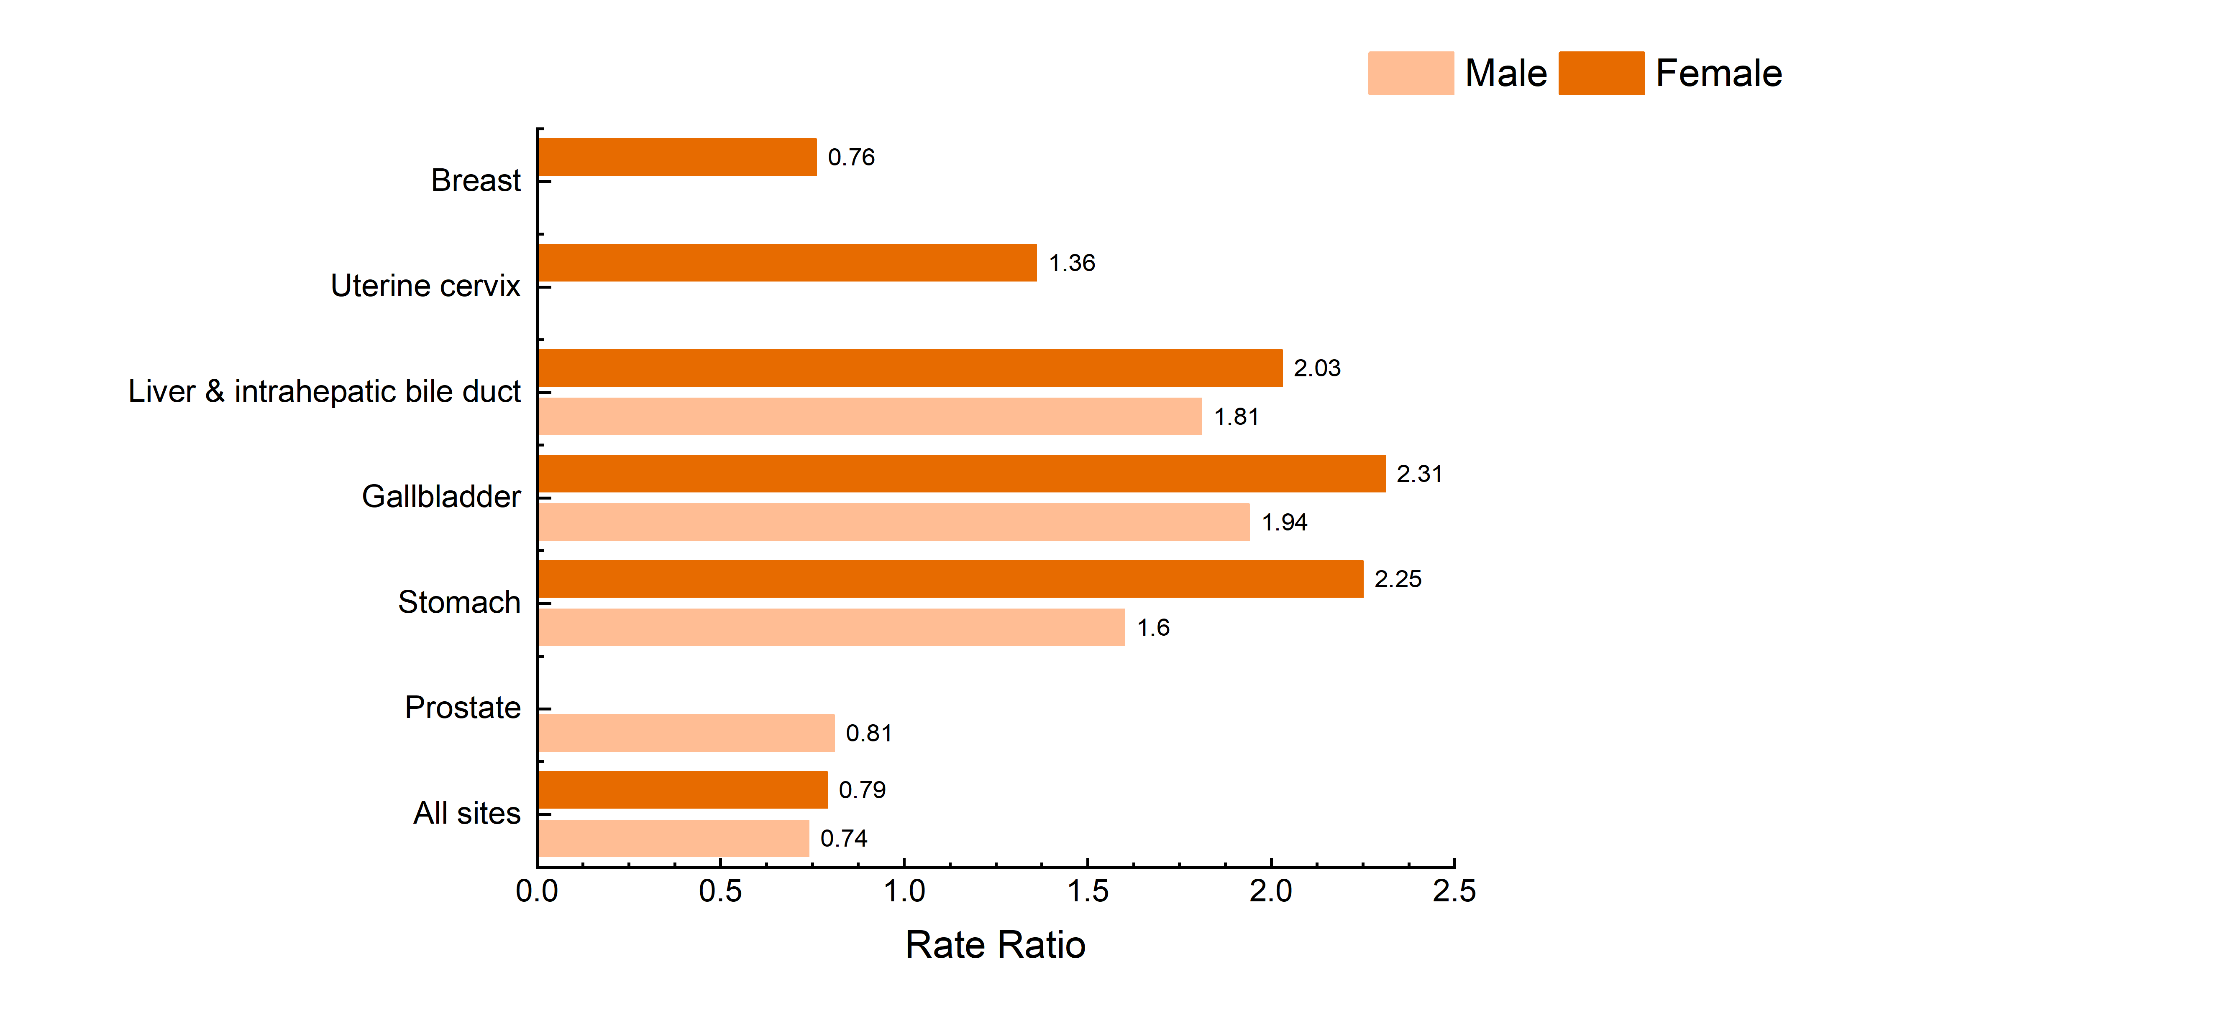
Age Adjusted Incidence Rate Ratios Among Hispanic People Compared to White People For Selected Cancers, US, 2017-2021
Cancer Facts & Figures for Hispanic/Latino People 2024-2026
White=Non-Hispanic White. All rate ratios presented were statistically significant (p < 0.05). Incidence rates are adjusted for delays in reporting and age adjusted to the 2000 US standard population. Rate ratios are unrounded rates in Hispanic people divided by the unrounded rates in Whites.
Source: Incidence – North American Association of Central Cancer Registries, 2024.
©2024, American Cancer Society, Inc., Surveillance and Health Equity Science
Notes:
Hispanic people have lower incidence than White people for the most common cancers, but about 2 times higher rates of stomach and liver cancer and 36% higher incidence for cervical cancer, all of which are associated with infectious agents and largely preventable.

Slide 9
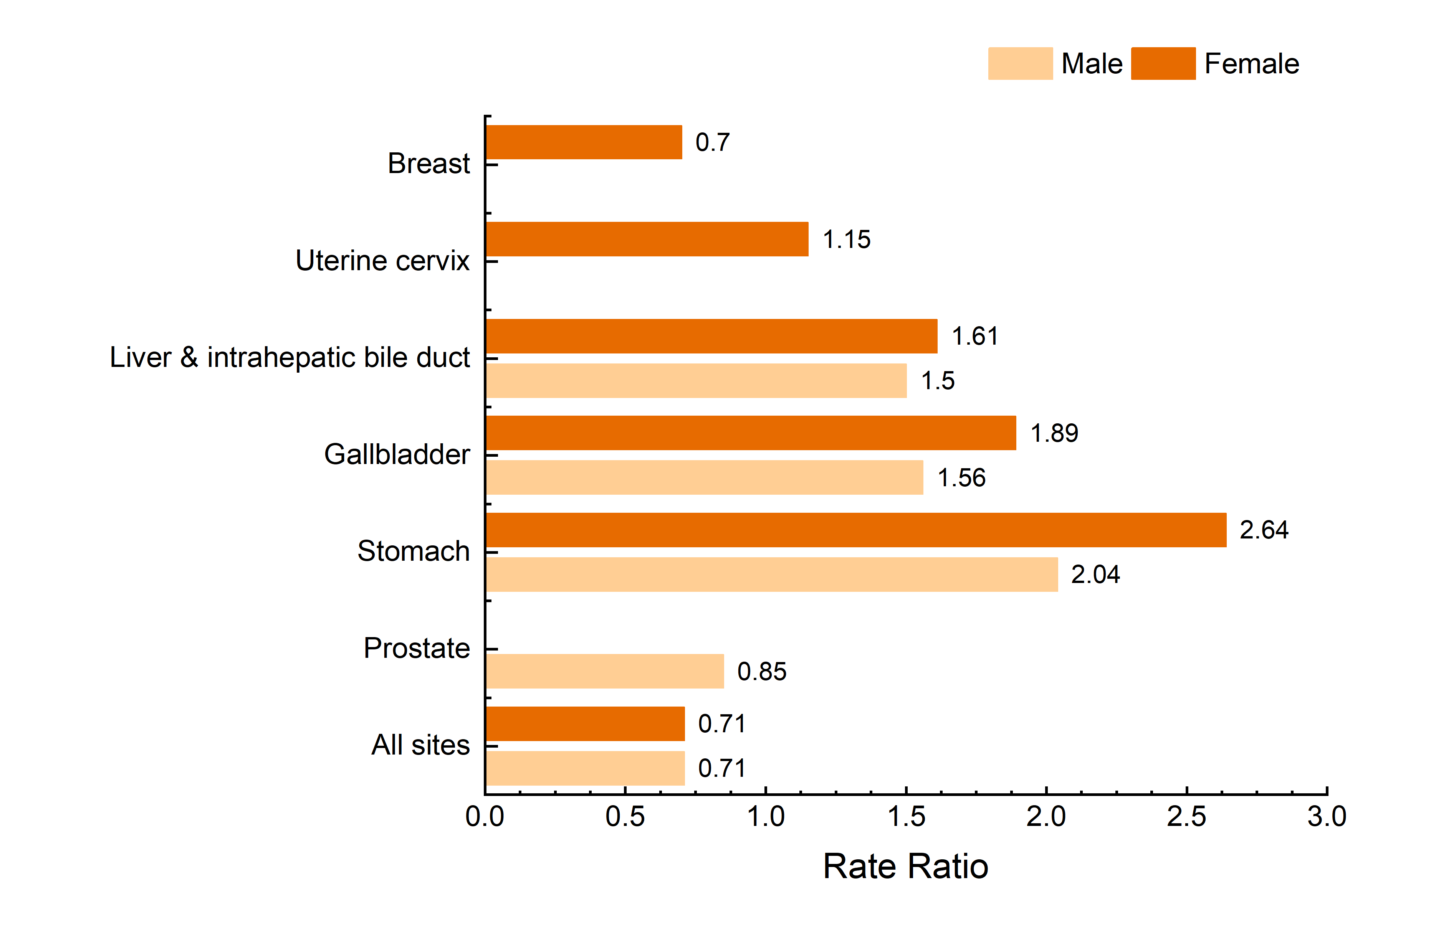
Age Adjusted Mortality Rate Ratios Among Hispanic People Compared to White People For Selected Cancers, US, 2018-2022
Cancer Facts & Figures for Hispanic/Latino People 2024-2026
White=Non-Hispanic White. All rate ratios presented were statistically significant (p < 0.05). Rates are age adjusted to the 2000 US standard population. Rate ratios are unrounded rates in Hispanic people divided by the unrounded rates in Whites.
Source: Mortality – National Center for Health Statistics, Centers for Disease Control and Prevention, 2024.
©2024, American Cancer Society, Inc., Surveillance and Health Equity Science
Notes:
Similar to incidence, Hispanic people have death rates that are approximately 50-61% higher for liver cancer and 2-fold higher for gallbladder and stomach cancer compared to White people.

Slide 10
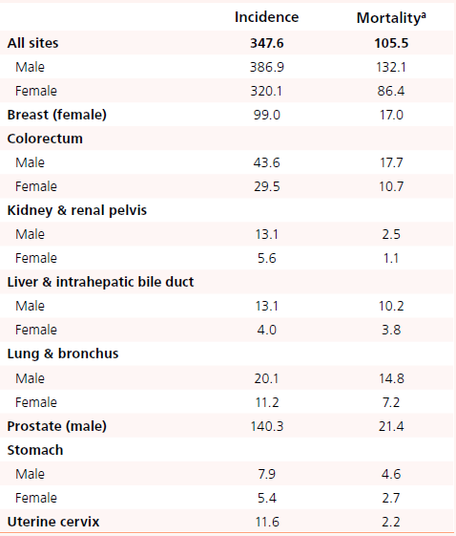
Cancer Incidence (2017-2021) and Mortality (2016-2020) Rates for Selected Cancers, Puerto Rico
Cancer Facts & Figures for Hispanic/Latino People 2024-2026
Rates are per 100,000 and are age adjusted to the 2000 US standard population. Rates for Puerto Rico exclude cases diagnosed in the latter half of 2017 due to the impact of Hurricane Maria. Incidence rates for colorectum cancer exclude appendix. ªDeath rates for Puerto Rico were obtained from statecancerprofiles.cancer.gov.
Sources: Incidence -- North American Association of Central Cancer Registries, 2024. Mortality – National Vital Statistics System, National Cancer Institute, 2023.
©2024, American Cancer Society, Inc., Surveillance and Health Equity Science
Notes:
Incidence rates for cervical cancer among women in Puerto Rico are about 18% and 61% higher, respectively, compared to Hispanic and White women in the US. This is likely due to higher prevalence of HPV and lower screening rates, especially among younger women.

Slide 11
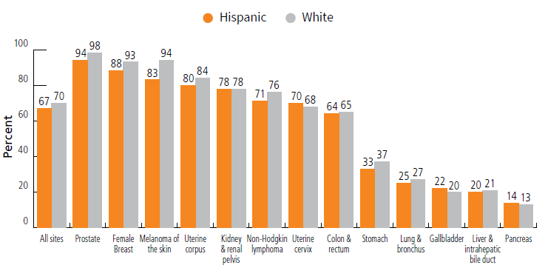
Five-year Relative Survival Rates (%) in Hispanic and White People, US, 2014-2020
Cancer Facts & Figures for Hispanic/Latino People 2024-2026
White=Non-Hispanic White. Rates are based on cases diagnosed in the SEER 22 areas from 2014 to 2020, followed through 2021. Survival rates should be interpreted with caution.
Source: Surveillance, Epidemiology, and End Results Program, National Cancer Institute, 2024.
©2024, American Cancer Society, Inc., Surveillance and Health Equity Science
Notes:
The largest survival disparity is for melanoma (94% versus 83%), at least in part reflecting later stage at diagnosis, more aggressive subtypes, and longer time to surgical treatment due to barriers to care.

Slide 12
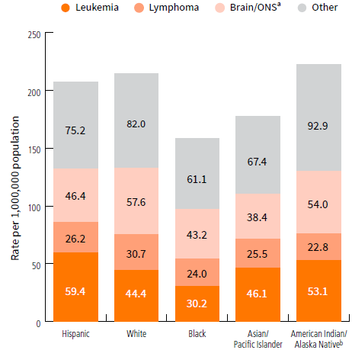
Common Childhood Adolescent Cancer Incidence Rates by Race and Ethnicity, Ages 0-19 Years, US, 2017-2021
Cancer Facts & Figures for Hispanic/Latino People 2024-2026
ONS=other nervous system. Rates are per 1,000,000 and age adjusted to the 2000 US standard population. ªIncludes benign and borderline brain tumors. ^{b}Data based on Indian Health Service Contract Health Service Delivery Area counties. Rates should be interpreted with caution due to small case numbers.
Source: North American Association of Central Cancer Registries, 2024.
©2024, American Cancer Society, Inc., Surveillance and Health Equity Science
Notes:
Leukemia incidence (mostly lymphoid leukemia) is higher in children and adolescents who are Hispanic than in any other racial or ethnic group, almost 2 times higher than in those who are Black (59.4 versus 30.2 per 1,000,000), who have the lowest rates, and about 30% higher than those who are White.

Slide 13
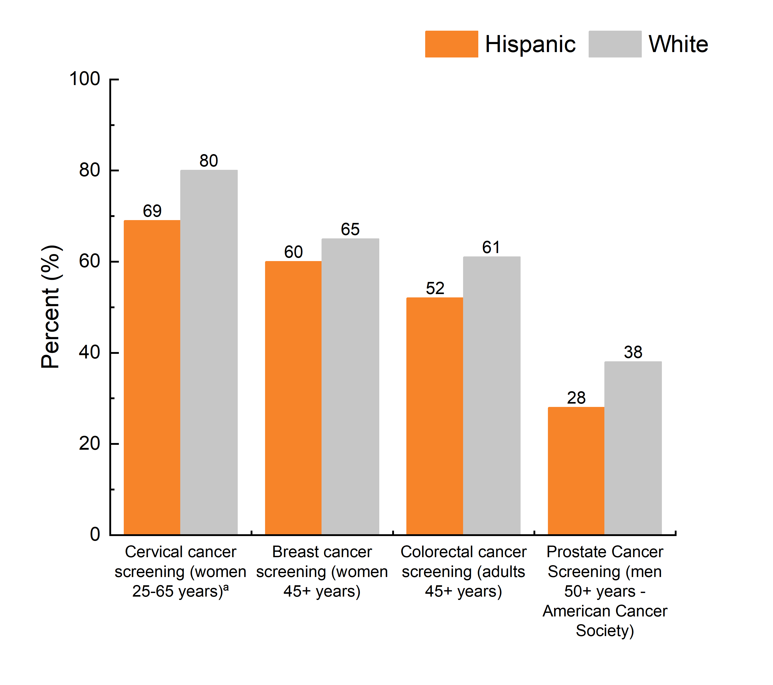
Up-to-date Cancer Screening Prevalence (%) Among Hispanic and White People for Selected Cancers, US, 2021
Cancer Facts & Figures for Hispanic/Latino People 2024-2026
White=Non-Hispanic White. ªAmong women with an intact uterus. Prostate cancer screening is defined among males who have not been diagnosed with prostate cancer who were screened within the past year.
Source: National Health Interview Survey, 2021.
©2024, American Cancer Society, Inc., Surveillance and Health Equity Science
Notes:
Hispanic people are less likely than White people to be screened for cervical (69% vs 80%), breast (60% vs 65%), colorectal (52% vs 61%), and prostate (28% vs 38%) cancers. Disparities in cancer screening in part reflect less access to care. Hispanic adults younger than 65 are more than three times as likely to be uninsured.

Slide 14
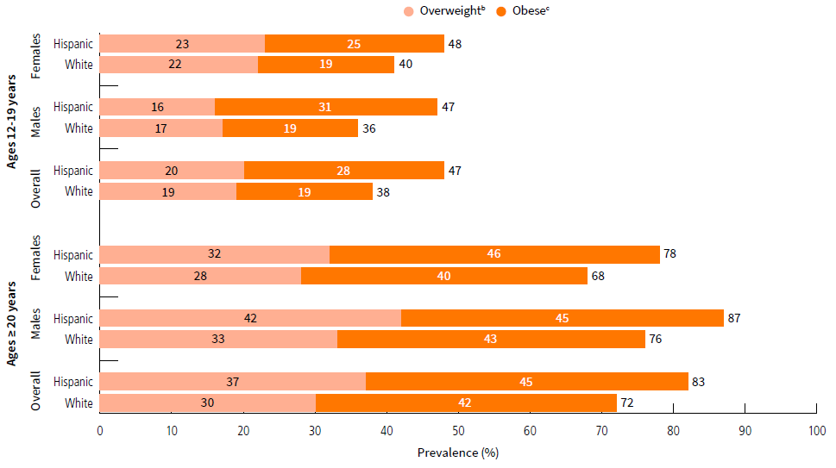
Excess Body Weightª (%) in Hispanics and Whites by Age, US, 2017-2020
Cancer Facts & Figures for Hispanic/Latino People 2024-2026
White=Non-Hispanic White. ªOverweight or obese. ^{b}In ages ≥20 years, 25.0 kg/m2 ≤ BMI < 30.0 kg/m2. In ages 12-19 years, BMI at or above 85th percentile but below 95th percentile of Centers for Disease Control and Prevention growth chart. ^{c}In ages ≥20 years, BMI ≥30.0 kg/m2. In ages 12-19 years, BMI at or above 95th percentile of CDC growth chart. Sum of estimates for overweight and obese may not equal total excess body weight value presented due to rounding.
Source: National Health and Nutrition Examination Survey Data, 2017-2020.
©2024, American Cancer Society, Inc., Surveillance and Health Equity Science
Notes:
Hispanic people have higher obesity than White people, with the largest gap for Hispanic adolescent males, 31% of whom have obesity compared to 19% of their White counterparts.

Slide 15

Thank You!
©2024, American Cancer Society, Inc.

