Slide 2
Notes:
This slide presents estimates for new cancer cases and deaths among Black people in 2025. In the US, Black people make up 14% of the population and are the second largest racial/ethnic minority group following Hispanic/Latino people. In 2025 there will be 248,470 new cancer diagnoses among Black people in the United States and 73,240 cancer deaths.

Slide 3
Notes:
This slide shows long-term trends in cancer incidence and mortality rates for all sites combined by sex. Incidence rates for all cancers combined generally declined in Black men from the mid-1990s until 2014 and remained stable thereafter through 2021. Overall incidence among Black women is also stable in recent years after increasing slowly (by 0.5% per year) during the 2000s. In contrast, the overall cancer death rate declined in Black men and women by 2.4% and 1.8% per year, respectively, in the past decade.

Slide 4
Notes:
This graph (continued on the next slide) shows long term trends in mortality and rate ratios by race and site from 1990 to 2022. The decreasing racial disparity in cancer mortality is driven by a faster decline in Black people, especially men, because of steeper reductions in lung and other smoking related cancers.

Slide 5
Notes:
Faster declines in prostate cancer mortality in Black versus White men also contribute the narrowing disparity gap. In contrast, the breast cancer disparity has changed little since peaking in 2011 when Black women had a 44% higher breast cancer death rate than White women. In 2022, the rate remained 38% higher in Black women.

Slide 6
Notes:
This graph shows the relative decline from 1991 to 2022 by age, race, and sex. The cancer death rate declined from 1991 to 2022 by 49% and 33% in Black men and women, respectively, compared to 36% and 26% in White men and women, because of advances in treatment, earlier detection for some cancers, and historical reductions in smoking that were steeper among Black people, especially males.

Slide 7
Notes:
This graph shows five-year relative survival rates by race and stage at diagnosis by cancer site. Survival is lower in Black people compared to White people for almost every cancer type; for example, the 5-year relative survival rate for uterine corpus cancer is 63% in Black women versus 84% in White women, largely due to later stage diagnosis, more aggressive disease, and less access to high-quality treatment.

Slide 8
Notes:
This slide shows trends in the leading cause of death in Black men and women from 1969 to 2022. Lung cancer is the leading cause of cancer death in Black men but was surpassed by breast cancer in 2022 among Black women.

Slide 9
Notes:
This slide shows trends in obesity prevalence for adults aged 20-74 years by sex and race. While Black men have similar obesity prevalence as White men and women, Black women have long had much higher prevalence, increasing their risk of many cancers (e.g., uterine corpus, stomach [cardia], and colorectal).

Slide 10
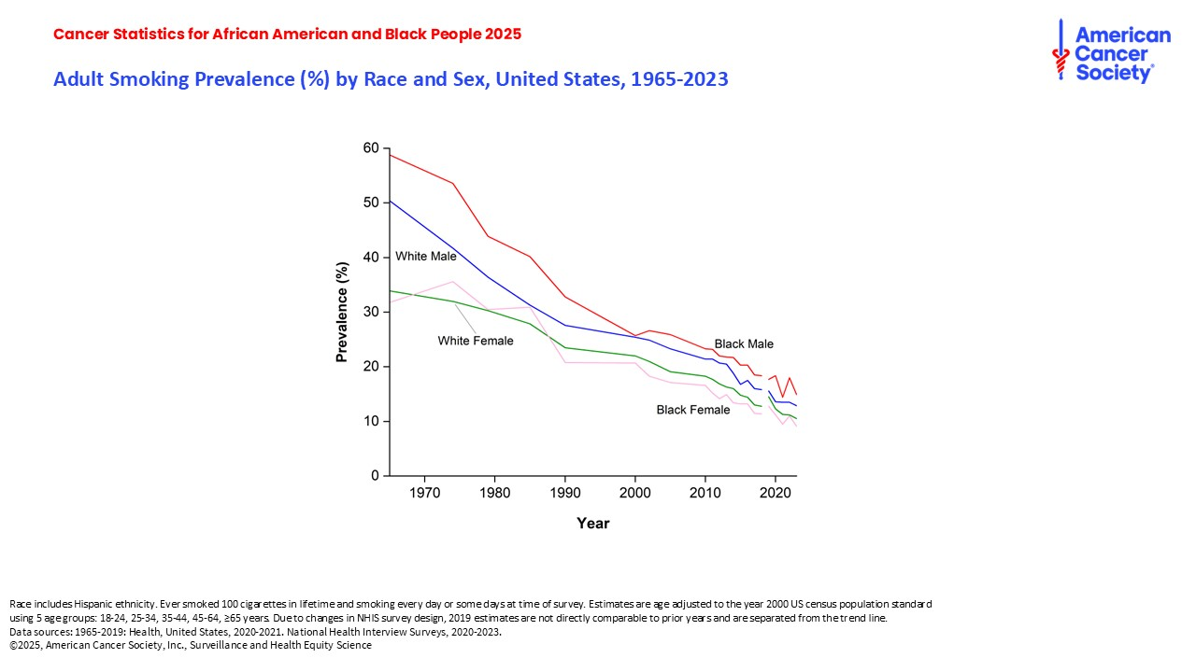
Notes:
This slide shows long term smoking prevalence by race and sex. Lung cancer occurrence largely reflects historical smoking patterns, which has declined considerably since 1965, and continues to be highest in Black men.

Slide 11
Notes:
This graph shows long term trends in incidence from 1995 to 2021 among Black people by selected cancer type. Prostate cancer incidence has increased by 2.6% per year in Black men since 2014, largely driven by diagnoses of advanced (regional and distant stage) disease. Similarly, uterine corpus cancer incidence continues to increase in Black women by 2% per year. Other cancers with increasing incidence trends in Black people include female breast (1.5% per year) and myeloma (2% per year in both men and women).

Slide 12
Notes:
This slide shows long term trends in lung cancer incidence by age, race, and sex. Steeper smoking declines in Black people than in White people, particularly among youth in the 1970s and 1980s, have resulted in converging lung cancer incidence overall and an elimination in the racial disparity among individuals younger than 50 years.

