Slide 2
How common is prostate cancer?

Slide 4
What is prostate cancer?

Slide 5
The prostate is necessary for reproduction

Slide 6
How does prostate cancer start?

Slide 8
What puts someone at risk for prostate cancer?

Slide 9
Prostate cancer risk factors

Slide 10
Prostate cancer risk factors

Slide 11
What are the symptoms of prostate cancer?

Slide 12
Prostate cancer signs & symptoms

Slide 13
Can prostate cancer be prevented?

Slide 14
Ways to lower your prostate cancer risk

Slide 17
Be careful when using medicines to lower prostate cancer risk

Slide 18
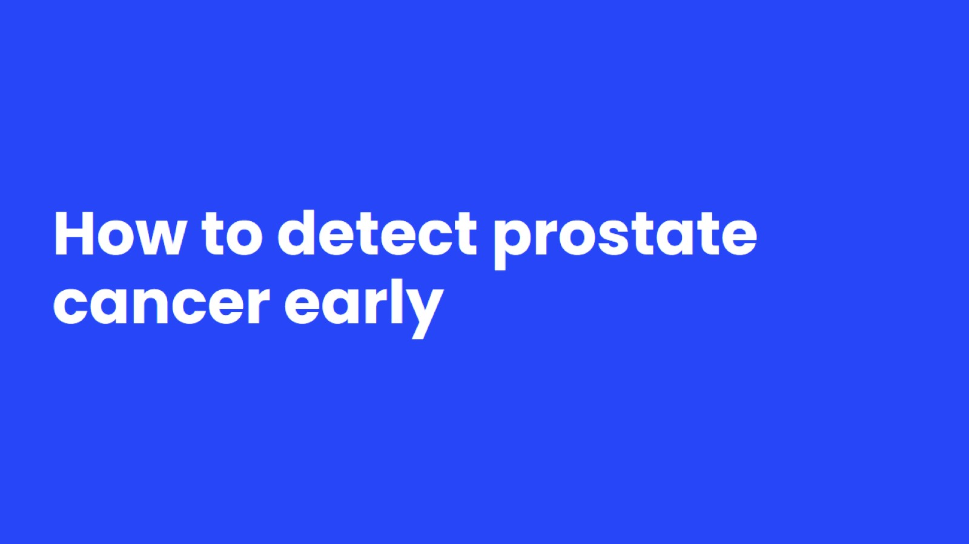
How to detect prostate cancer early

Slide 19
Prostate cancer screening

Slide 20
What are the options for screening?

Slide 21
Limitations of prostate cancer screening

Slide 22
How to make an informed decision about screening

Slide 24
You can get more information on prostate cancer and prostate cancer screening on our website, cancer.org, or call 1-800-227-2345 and talk with one of our Cancer Information Specialists.

